Slide 1
Concepts and Comments
Navajo Sand Painting
Braille
English- the international language
Captain cook
Conserving the world’s natural resources
No smoking

Slide 2
Navajo Sand Painting

Slide 4
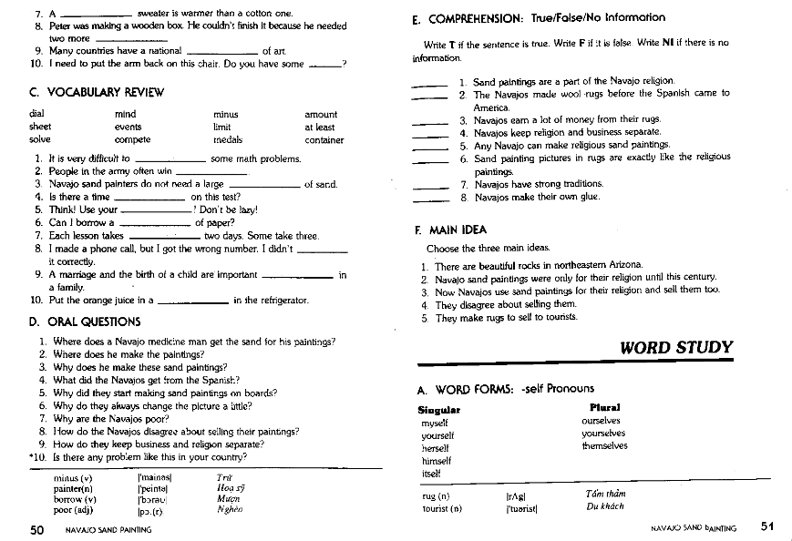

Slide 5
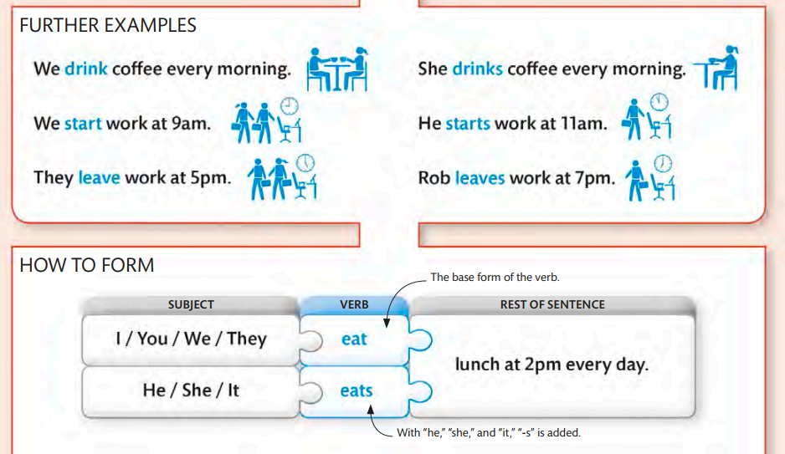
Simple Present

Slide 8
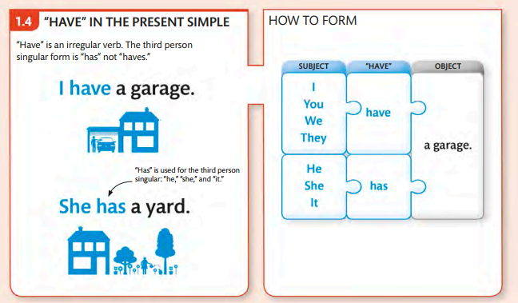

Slide 9
Perposition

